Slide 1


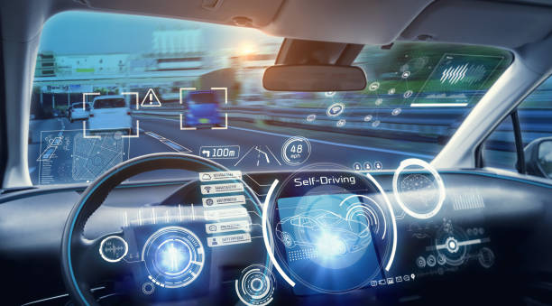
Introduction to Self-Driving Car

Slide 2
Overview
Introduction to self-driving car
What is Automation
Levels of Automation
Knowledge of Hardware & Software
Typology of self-driving car
Perception analysis of automated systems
Decisions making and actions

Slide 3
Overview
SDC
Background
Innovation
Introduction to self-driving car
What is Automation
Levels of Automation
Knowledge of Hardware & Software
Typology of self-driving car
Perception analysis of automated systems
Decisions making and actions

Slide 4

Overview
Car Based on Human perception
Source: https://readesh.com/five-crucial-driving-tips-parents-teach/

Slide 5
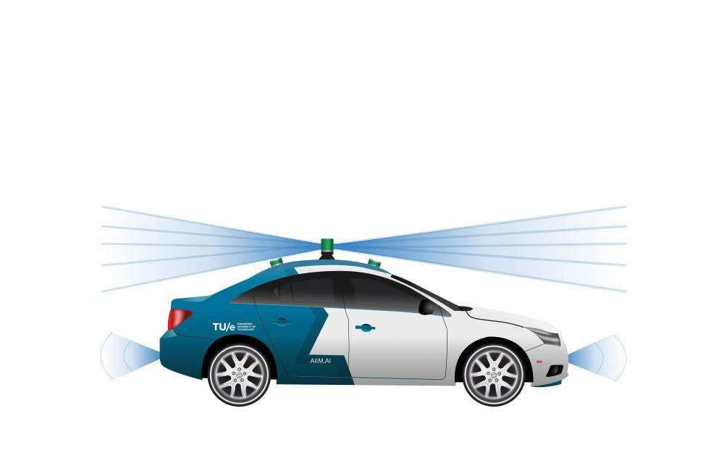
Overview
Car based on Sensors
Source: https://www.exos.ir/tag/TagArchives

Slide 6
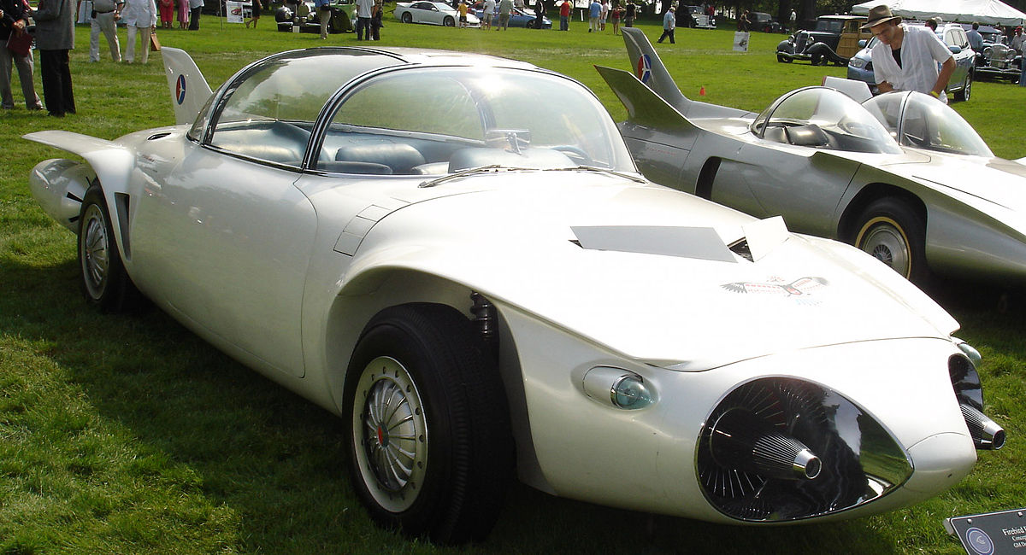
Overview
First Self-Driving Car, 1939
Source: https://en.wikipedia.org/wiki/History_of_self-driving_cars#/media/File:FirebirdII.jpg

Slide 7
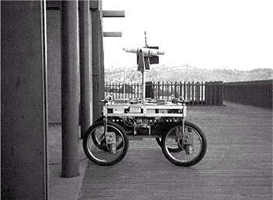
Overview
Moon Surface Drivable Car, 1961
Source : http://cyberneticzoo.com/tag/james-l-adams/

Slide 8
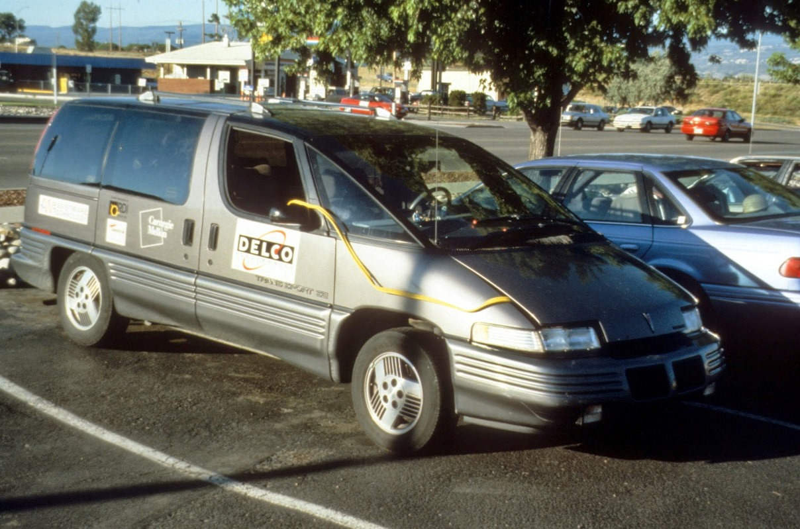
Overview
Navlab Self-Driving Car, 2003
Source : http://cyberneticzoo.com/tag/james-l-adams/

Slide 9
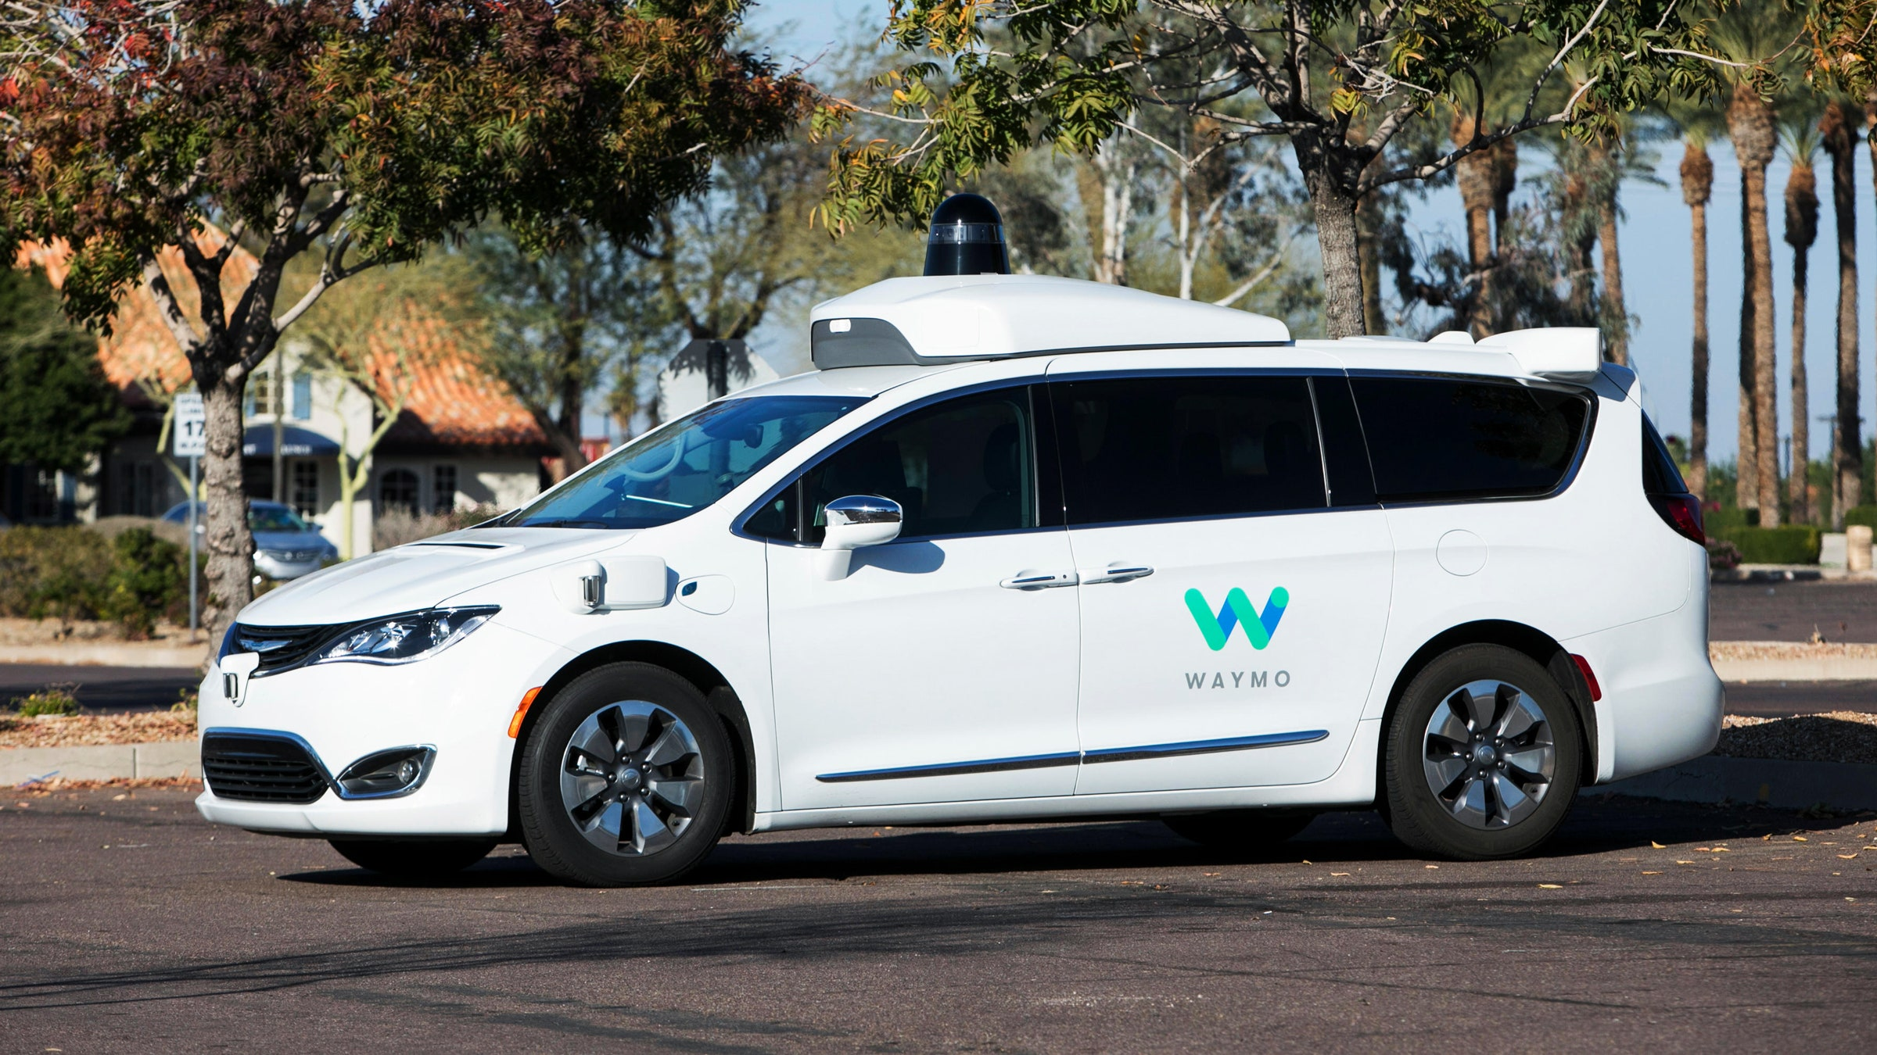
Overview
Waymo Self-Driving Car, 2009
Source: https://www.wired.com/story/waymo-self-driving-cars-california/

Slide 10
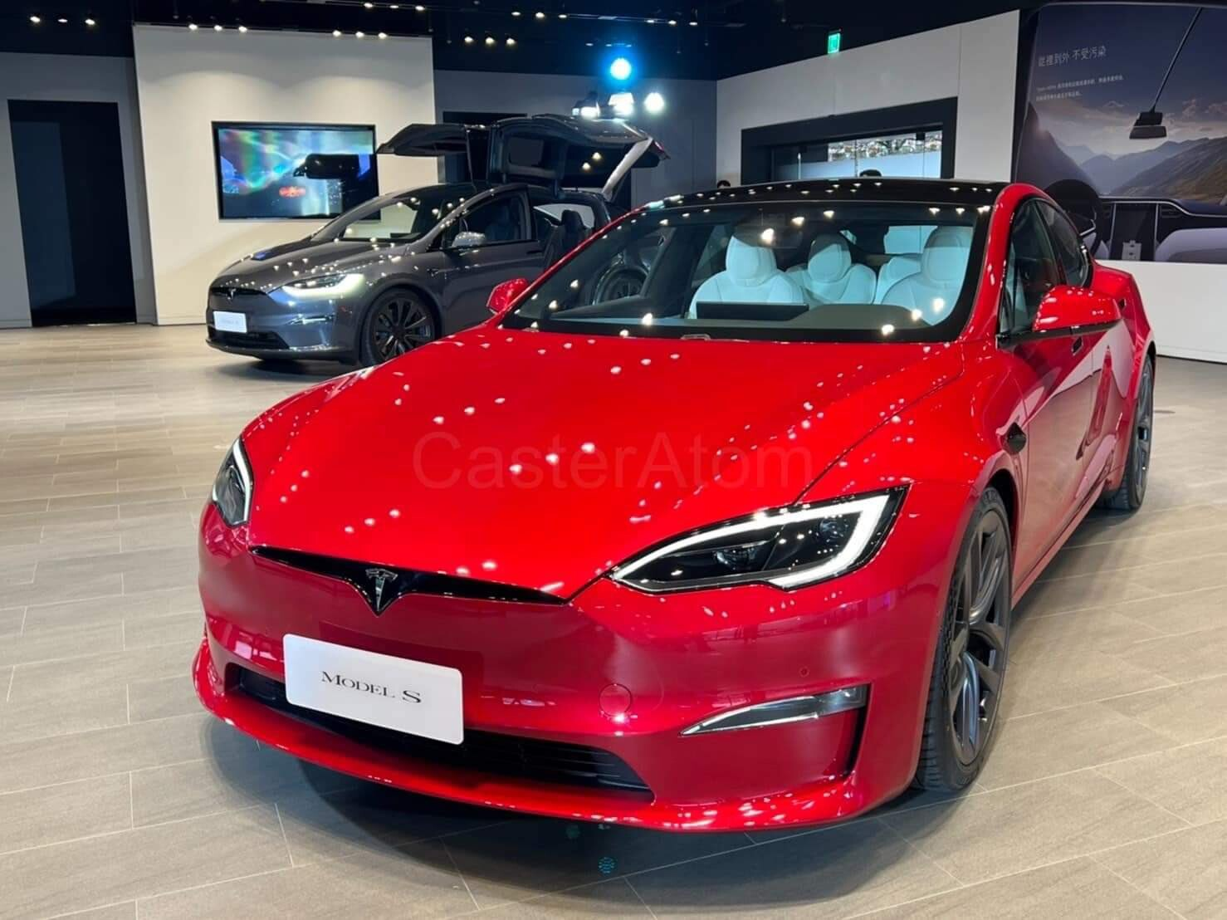
Overview
Tesla Self-Driving Car, 2012
Source: https://www.extremetech.com/extreme/147940-google-self-driving-cars-in-3-5-years-feds-not-so-fast

Slide 11
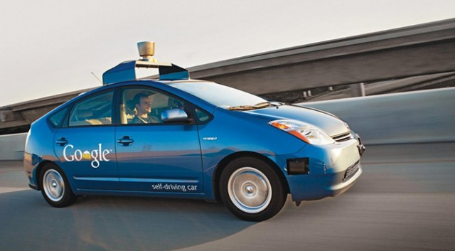
Overview
Google Self-Driving Car, 2013
Source: https://www.extremetech.com/extreme/147940-google-self-driving-cars-in-3-5-years-feds-not-so-fast

Slide 12
Overview
Automation
Comparison
Introduction to self-driving car
What is Automation
Levels of Automation
Knowledge of Hardware & Software
Typology of self-driving car
Perception analysis of automated systems
Decisions making and actions

Slide 13
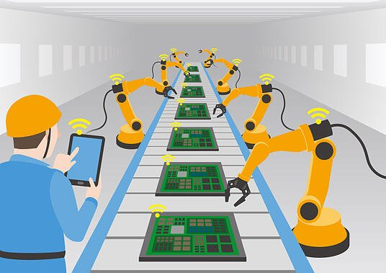
Overview
What is Automation
Source: https://blog.robotiq.com/whats-the-difference-between-automation-and-robotics

Slide 14
Overview
Level 0: No Automation
Level 1: Driver Assistance
Level 2: Partial Automation
Level 3: Conditional Automation
Level 4: High Automation
Level 5: Full Automation
Introduction to self-driving car
What is Automation
Levels of Automation
Knowledge of Hardware & Software
Typology of self-driving car
Perception analysis of automated systems
Decisions making and actions

Slide 15
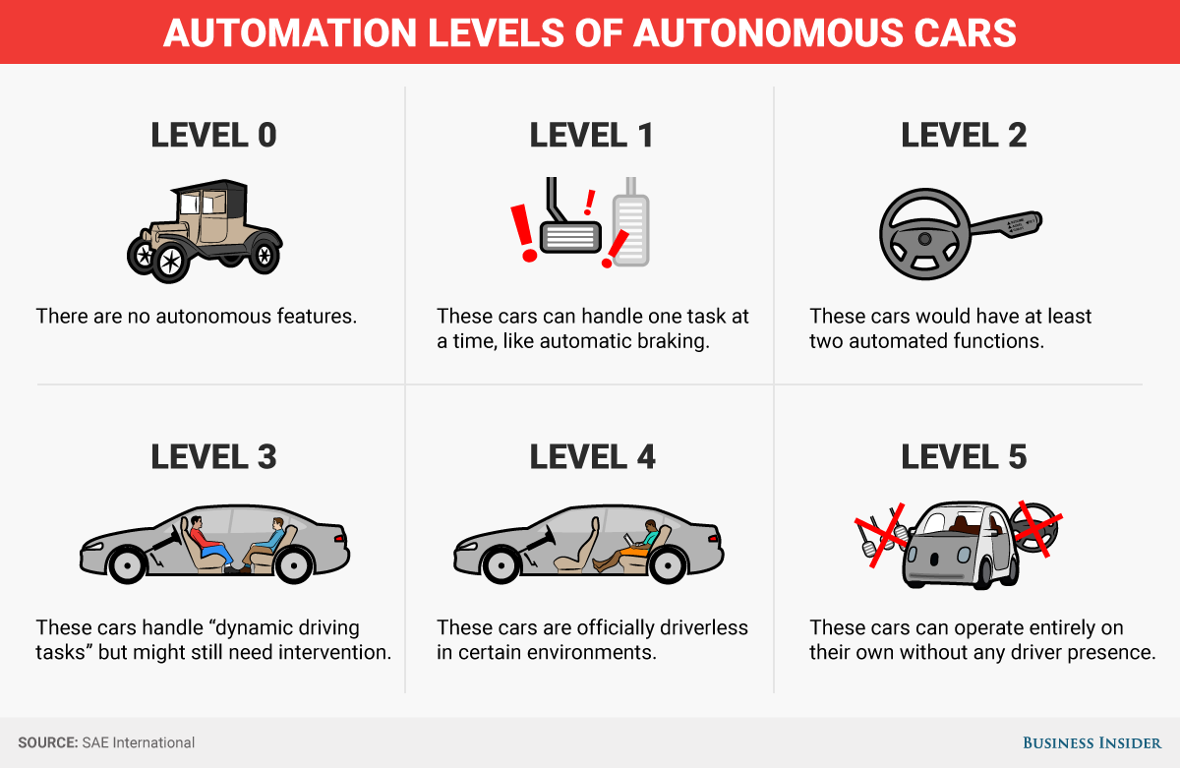
Overview
Levels of Automation
Source: https://mansmindpalace.wordpress.com/2017/05/11/first-blog-post/

Slide 16
No Automation
Partial Automation
High Automation
Driver Assistance
Conditional Automation
Full Automation
Level 0
Level 2
Level 1
Level 3
Level 4
Level 5

Slide 17
Overview
Software
Hardware
Introduction to self-driving car
What is Automation
Levels of Automation
Knowledge of Hardware & Software
Typology of self-driving car
Perception analysis of automated systems
Decisions making and actions

Slide 18
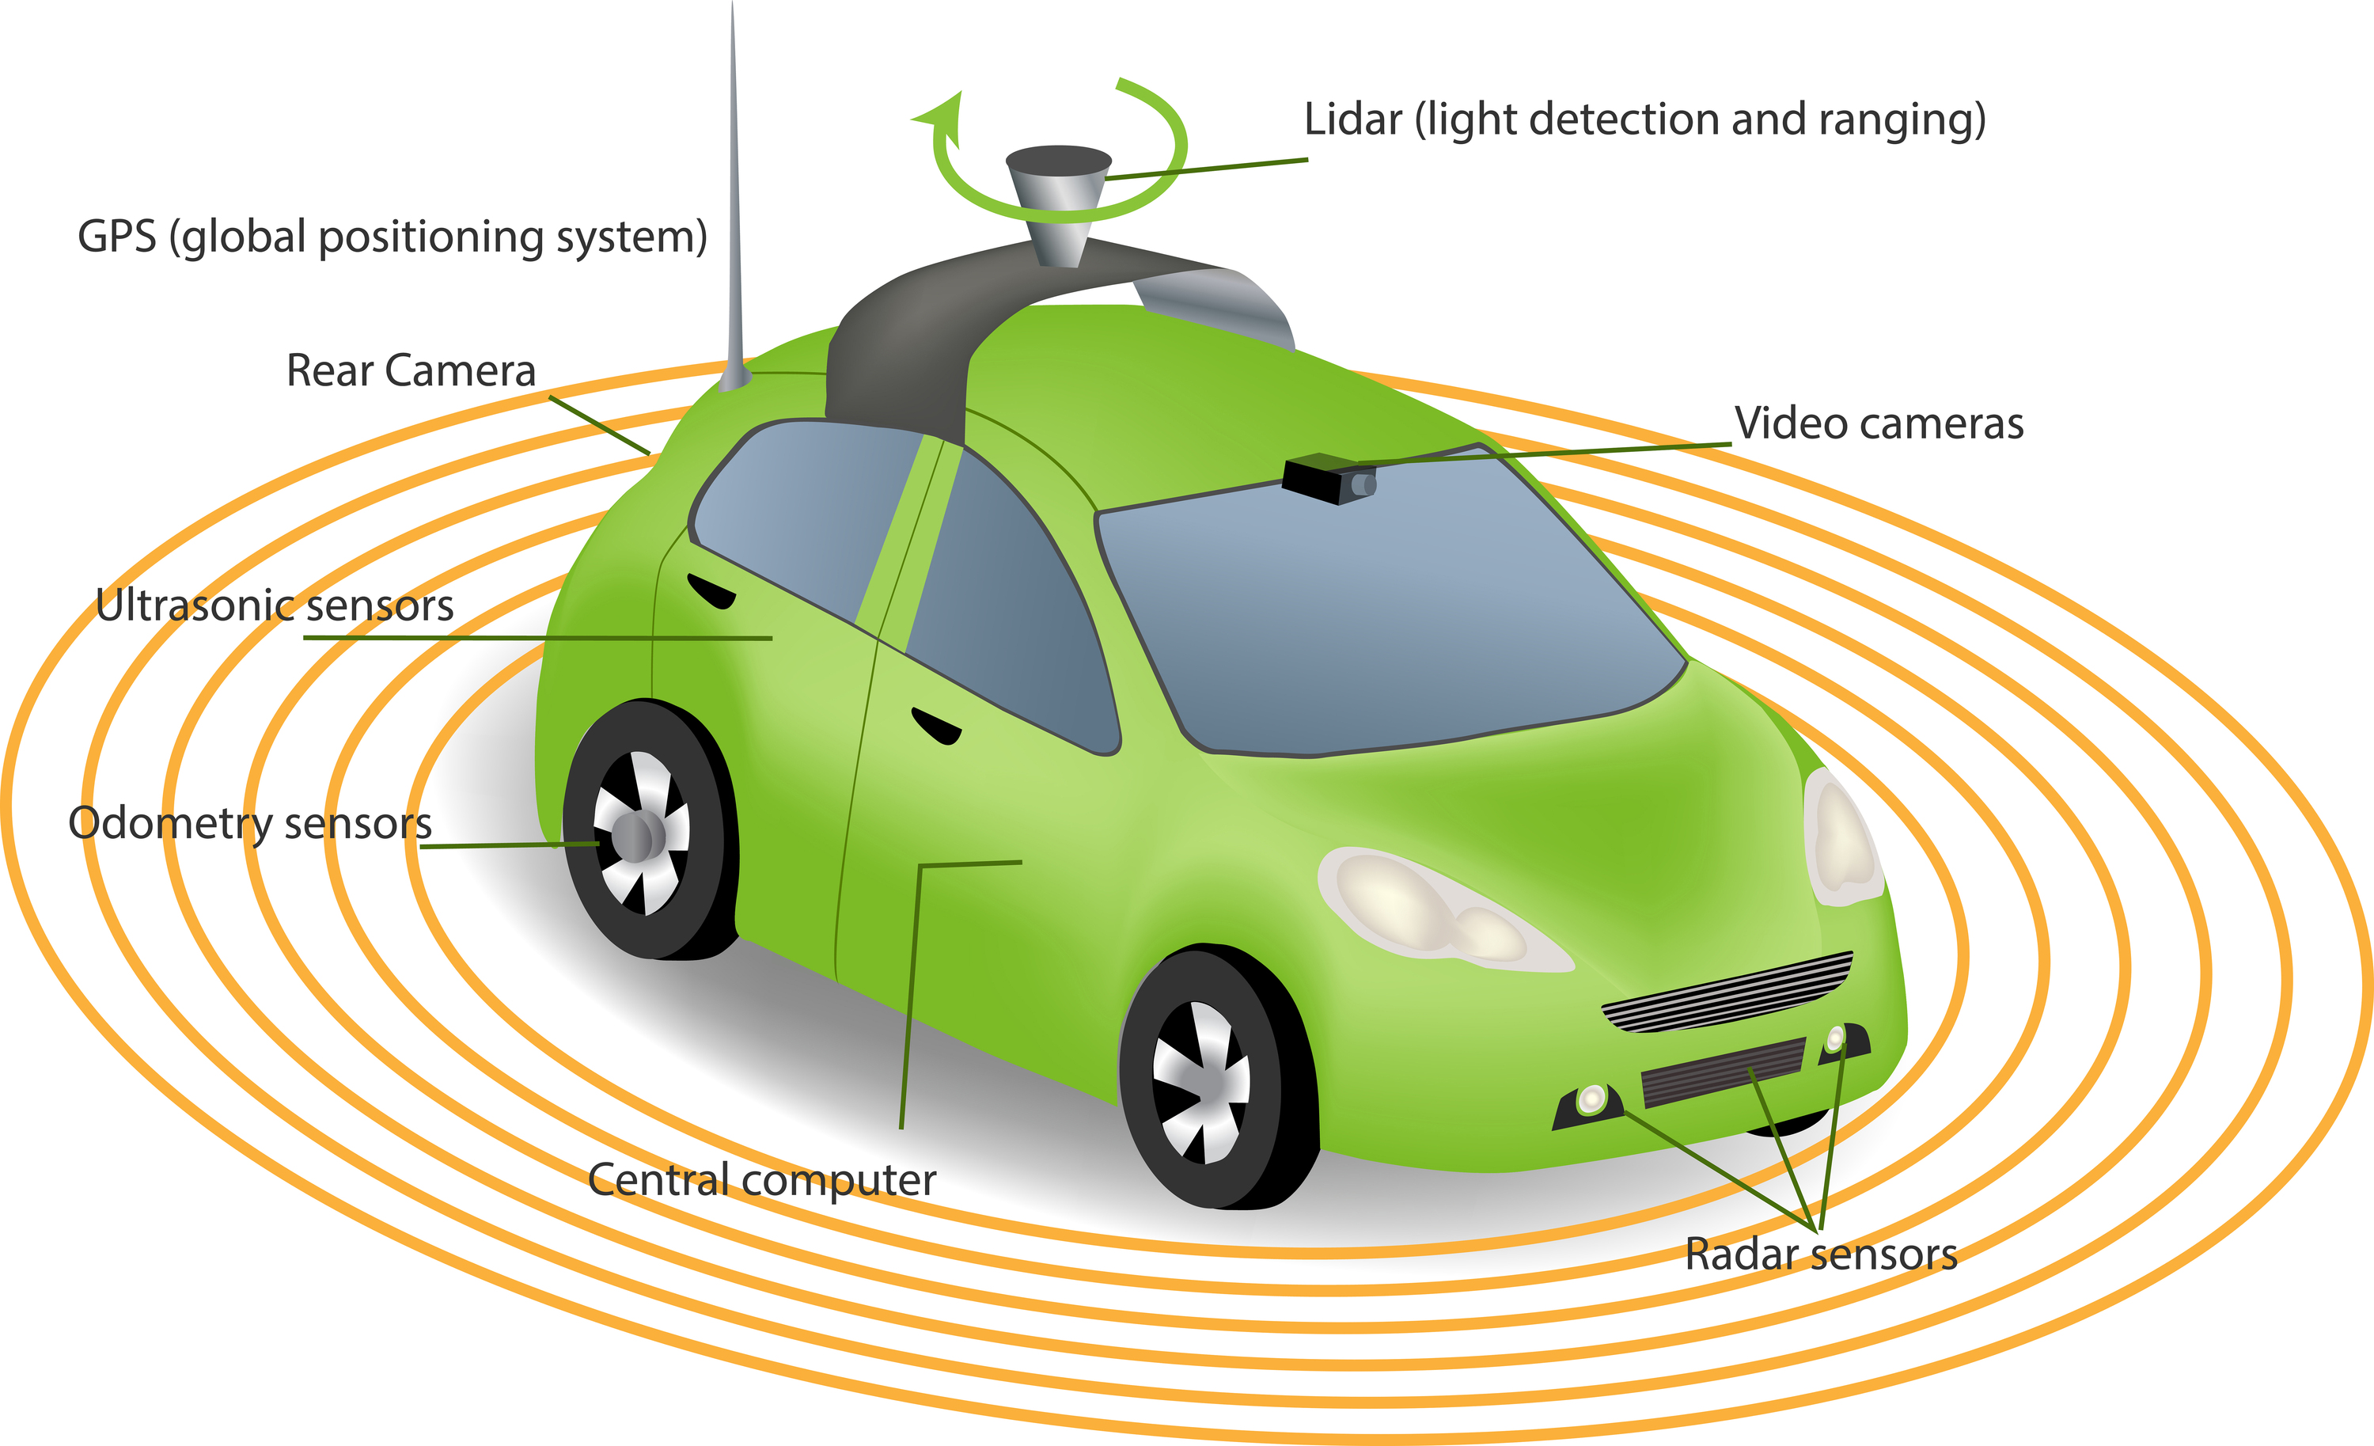
Overview
Knowledge of Hardware & Software
Source: https://innovationatwork.ieee.org/lidr-is-the-latest-game-changing-advancement-for-autonomous-vehicles/

Slide 19
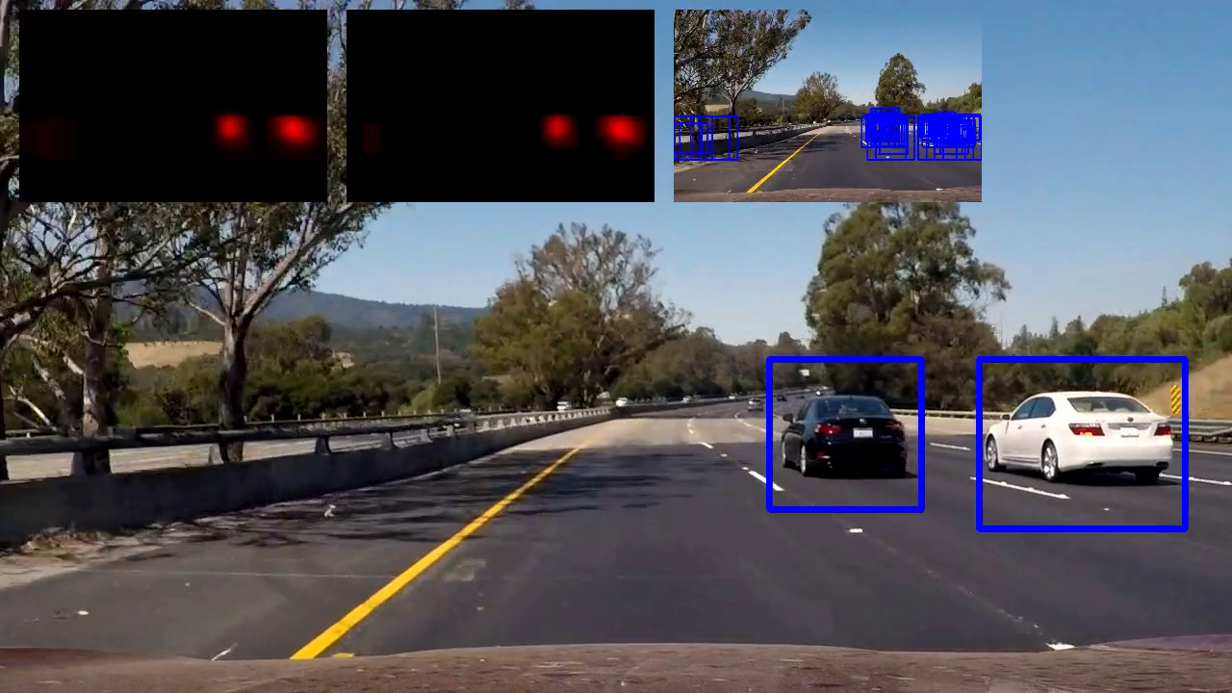
Overview
Computer Vision Based Perception SDC
Source: https://towardsdatascience.com/teaching-cars-to-see-vehicle-detection-using-machine-learning-and-computer-vision-54628888079a/

Slide 20
Overview
Driving task
Agenda of our SDC
Limitations
Introduction to self-driving car
What is Automation
Levels of Automation
Knowledge of Hardware & Software
Typology of self-driving car
Perception analysis of automated systems
Decisions making and actions

Slide 21
Overview
Safety Measures
Sensor Network
Introduction to self-driving car
What is Automation
Levels of Automation
Knowledge of Hardware & Software
Typology of self-driving car
Perception analysis of automated systems
Decisions making and actions

Slide 22
Overview
Event Detection
Planning
Response
Introduction to self-driving car
What is Automation
Levels of Automation
Knowledge of Hardware & Software
Typology of self-driving car
Perception analysis of automated systems
Decisions making and actions

Slide 23
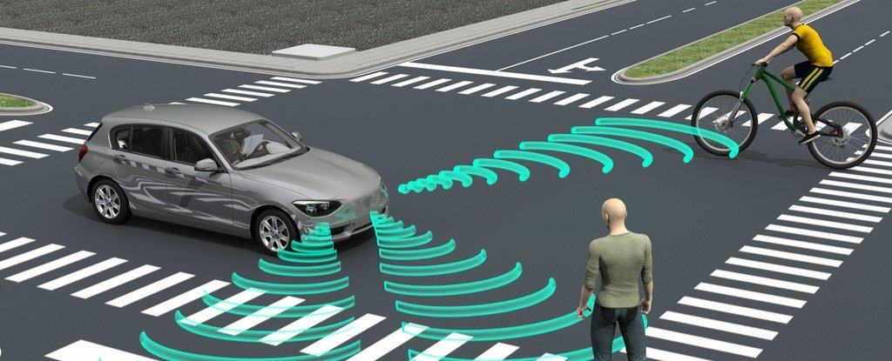
Overview
Decisions making and actions
Source: https://www.sciencealert.com/self-driving-cars-may-soon-be-making-moral-decisions-like-humans

Slide 24
Thank You

